Slide 1
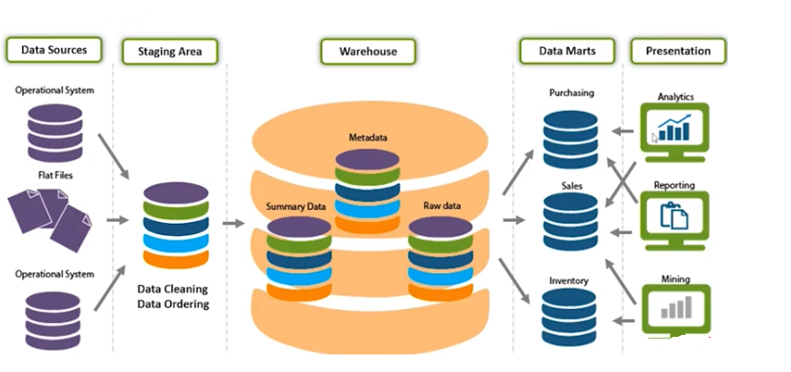
Data Warehousing

Slide 2
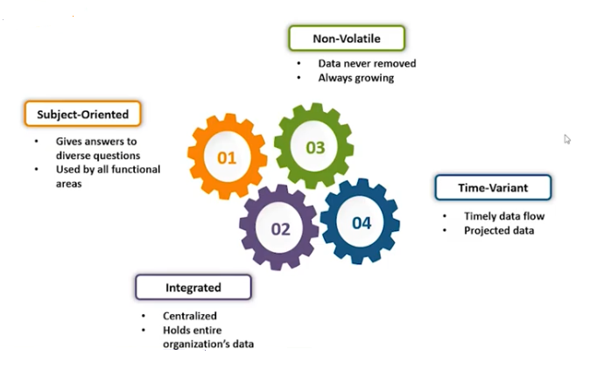
Data Warehousing Definition
Data Warehousing:
The process of constructing and using a data warehouse

Slide 3
Definition
Data Warehouse: (W.H. Immon)
A subject-oriented, integrated, time-variant, non-updatable collection of data used in support of management decision-making processes
Subject-oriented: e.g. customers, patients, students, products
Integrated: Consistent naming conventions, formats, encoding structures; from multiple data sources
Time-variant: Can study trends and changes
Nonupdatable: Read-only, periodically refreshed
Data Warehousing:
The process of constructing and using a data warehouse

Slide 4
Need for Data Warehousing
Integrated, company-wide view of high-quality information (from disparate databases)
Separation of operational and informational systems and data (for improved performance)
OLTP vs Data Warehouse
OLTP
Application Oriented
Used to run business
Detailed data
Current up to date
Isolated Data
Clerical User
Few Records accessed at a time (tens)
Read/Update Access
No data redundancy
Database Size 100MB -100 GB
Transaction throughput is the performance metric
Thousands of users
Warehouse (DSS)
Subject Oriented
Used to analyze business
Summarized and refined
Snapshot data
Integrated Data
Knowledge User (Manager)
Large volumes accessed at a time (millions)
Mostly Read (Batch Update)
Redundancy present
Database Size 100 GB - few terabytes
Query throughput is the performance metric
Hundreds of users

Slide 5

To summarize ...
OLTP Systems are used to “run” a business
The Data Warehouse helps to “optimize” the business

Slide 6
Data Warehouse Architectures
1.Generic Two-Level Architecture
2.Independent Data Mart
3.Dependent Data Mart and Operational Data Store
4.Three-Layer architecture
All involve some form of extraction, transformation and loading (ETL)

Slide 7
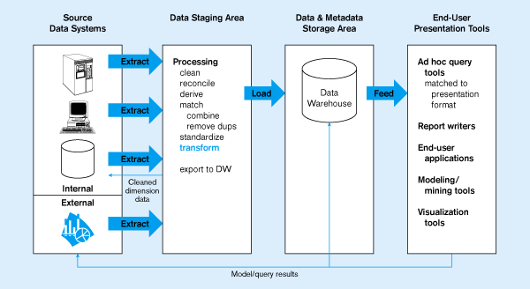
Figure 11-2: Generic two-level architecture
L
One, company-wide warehouse
T
E
Periodic extraction ➔ data is not completely current in warehouse

Slide 8
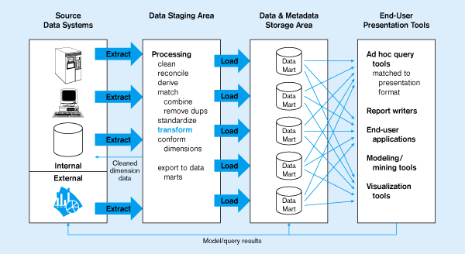
Figure 11-3: Independent Data Mart
Data marts:
Mini-warehouses, limited in scope
L
T
E
Separate ETL for each independent data mart
Data access complexity due to multiple data marts

Slide 9
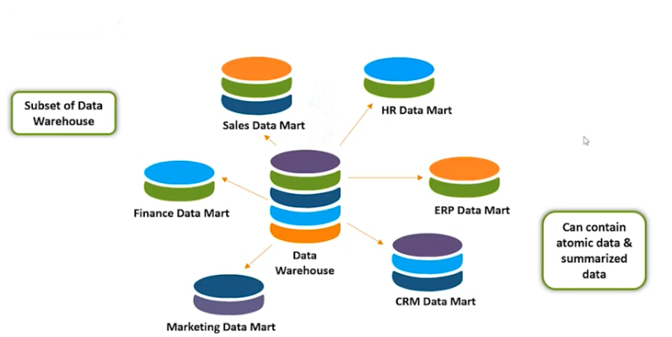
Independent Data mart

Slide 10
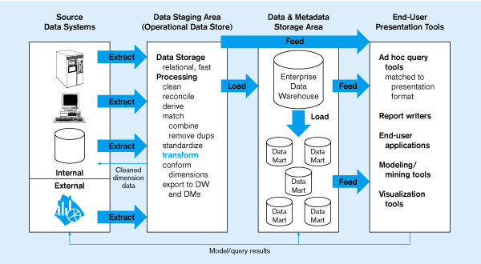
Figure 11-4:
Dependent data mart with operational data store
ODS provides option for obtaining current data
L
T
E
Simpler data access
Single ETL for
enterprise data warehouse
(EDW)
Dependent data marts loaded from EDW

Slide 11
Dependent data mart- Operational data store
Dependent data mart: A data mart filled exclusively from the enterprise data warehouse and its reconciled data.
Operational data store (ODS): An integrated, subject-oriented, updatable, current-valued, enterprise-wise, detailed database designed to serve operational users as they do decision support processing.

Slide 12
Three-layer architecture The Complete Decision Support System
Information Sources
Data Warehouse
Server
(Tier 1)
OLAP Servers
(Tier 2)
Clients
(Tier 3)
e.g., MOLAP
Semistructured
Sources
Analysis
Data
Warehouse
serve
extract
transform
load
refresh
etc.
Query/Reporting
serve
e.g., ROLAP
Operational
DB’s
serve
Data Mining
Data Marts

Slide 13
Three-Tier Decision Support Systems
Warehouse database server
Almost always a relational DBMS, rarely flat files
OLAP servers
Relational OLAP (ROLAP): extended relational DBMS that maps operations on multidimensional data to standard relational operators
Multidimensional OLAP (MOLAP): special-purpose server that directly implements multidimensional data and operations
Clients
Query and reporting tools
Analysis tools
Data mining tools

Slide 14
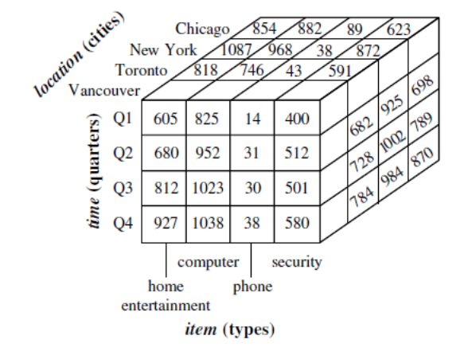
Multidimensional Data Model
Multidimensional Data Model
A data warehouse is based on a multidimensional data model which views data in the form of a data cube
A data cube, such as sales, allows data to be modeled and viewed in multiple dimensions
Dimension tables, such as item (item_name, brand, type), or time(day, week, month, quarter, year)
Fact table contains measures (such as dollars_sold) and keys to each of the related dimension tables

Slide 15
Conceptual Modeling of Data Warehouses
Modeling data warehouses: dimensions & measures
Star schema: A fact table in the middle connected to a set of dimension tables
Snowflake schema: A refinement of star schema where some dimensional hierarchy is normalized into a set of smaller dimension tables, forming a shape similar to snowflake
Fact constellations: Multiple fact tables share dimension tables, viewed as a collection of stars, therefore called galaxy schema or fact constellation

Slide 16
The Multi-Dimensional Model
“Sales by product line over the past six months”
“Sales by store between 1990 and 1995”
Store Info
Key columns joining fact table
to dimension tables
Numerical Measures
Prod Code Time Code Store Code Sales Qty
Fact table for
measures
Product Info
Dimension tables
Time Info
. . .

Slide 17
Example of Star Schema
time
time_key
day
day_of_the_week
month
quarter
year
item
item_key
item_name
brand
type
supplier_type
Sales Fact Table
time_key
item_key
branch_key
branch
location
location_key
branch_key
branch_name
branch_type
location_key
street
city
state_or_province
country
units_sold
dollars_sold
avg_sales
Measures

Slide 18
Example of Snowflake Schema
time
item
time_key
day
day_of_the_week
month
quarter
year
item_key
item_name
brand
type
supplier_key
supplier
Sales Fact Table
supplier_key
supplier_type
time_key
item_key
branch_key
branch
location
location_key
location_key
street
city_key
branch_key
branch_name
branch_type
units_sold
dollars_sold
city
city_key
city
state_or_province
country
avg_sales
Measures

Slide 19
Example of Fact Constellation
time
time_key
day
day_of_the_week
month
quarter
year
item
Shipping Fact Table
item_key
item_name
brand
type
supplier_type
Sales Fact Table
time_key
time_key
item_key
shipper_key
item_key
branch_key
from_location
branch
location_key
location
to_location
branch_key
branch_name
branch_type
units_sold
location_key
street
city
province_or_state
country
dollars_cost
dollars_sold
units_shipped
avg_sales
shipper
Measures
shipper_key
shipper_name
location_key
shipper_type

Slide 20
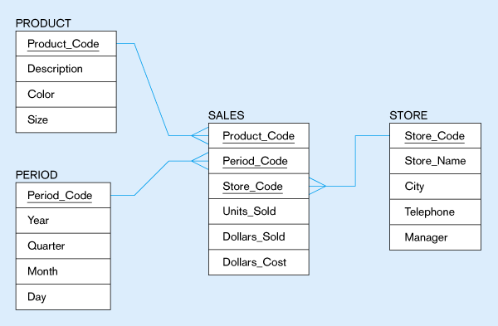
Figure 11-14: Star schema example
Fact table provides statistics for sales broken down by product, period and store dimensions

Slide 21
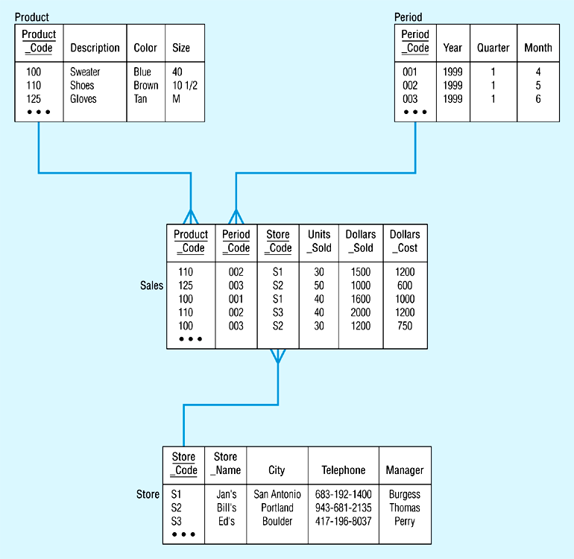
Figure 11-15: Star schema with sample data

Slide 22
Design star & snowflake schema for "Hotel Occupancy" considering
dimensions like Time, Hotel, Room, etc.
ii. Calculate the maximum number of base fact table records for the values given
below:
Time period: 5 years
Hotels: 150
Rooms: 750 rooms in each Hotel (about 400 occupied in each hotel daily)
Time dimension: 5 years × 365 days = 1825 *150 *400 =109500 records

Slide 23
Snowflake schema

Slide 24
MOLAP Cube
roll-up to region
Dimensions:
Time, Product, Store
Attributes:
Product (upc, price, …)
Store …
…
Hierarchies:
Product → Brand → …
Day → Week → Quarter
Store → Region → Country
NY
Store
SF
roll-up to brand
LA
Juice
Milk
Coke
Cream
Soap
Bread
10
34
56
32
12
56
Product
roll-up to week
M T W Th F S S
Time
56 units of bread sold in LA on M

Slide 25
The MOLAP Cube
Fact table view:
Multi-dimensional cube:
dimensions = 2

Slide 26
3-D Cube
Fact table view:
Multi-dimensional cube:
day 2
day 1
dimensions = 3

Slide 27
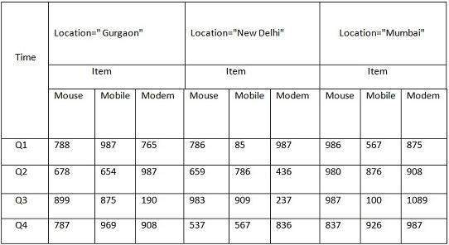
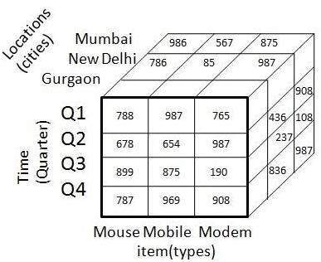
3-D table can be represented as 3-D data cube

Slide 28
OLAP Operations
Roll-up
Drill-down
Slice and dice
Pivot (rotate)

Slide 29
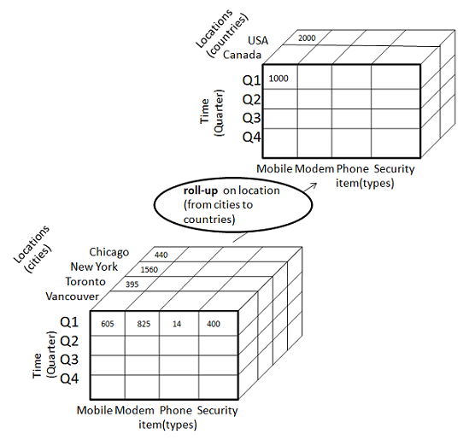
ROLL-UP
This operation performs aggregation on a data cube in any of the following way:
By climbing up a concept hierarchy for a dimension
By dimension reduction.
Consider the following diagram showing the roll-up operation.

Slide 30
ROLL-UP
The roll-up operation is performed by climbing up a concept hierarchy for the dimension location.
Initially the concept hierarchy was "street < city < province < country".
On rolling up the data is aggregated by ascending the location hierarchy from the level of city to level of country.
The data is grouped into cities rather than countries.
When roll-up operation is performed then one or more dimensions from the data cube are removed.

Slide 31
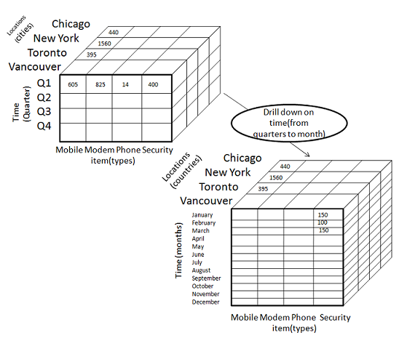
DRILL-DOWN
Drill-down operation is reverse of the roll-up. This operation is performed by either of the following way:
By stepping down a concept hierarchy for a dimension.
By introducing new dimension.
Consider the following diagram showing the drill-down operation:

Slide 32
DRILL-DOWN
The drill-down operation is performed by stepping down a concept hierarchy for the dimension time.
Initially the concept hierarchy was "day < month < quarter < year."
On drill-up the time dimension is descended from the level quarter to the level of month.
When drill-down operation is performed then one or more dimensions from the data cube are added.
It navigates the data from less detailed data to highly detailed data.

Slide 33
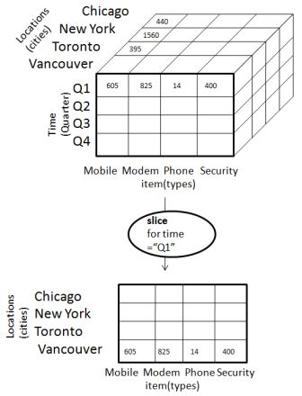
SLICE
The slice operation performs selection of one dimension on a given cube and give us a new sub cube. Consider the following diagram showing the slice operation
The Slice operation is performed for the dimension time using the criterion time ="Q1".
It will form a new sub cube by selecting one or more dimensions.

Slide 34
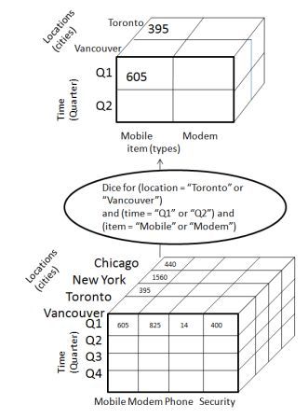
DICE
The Dice operation performs selection of two or more dimension on a given cube and give us a new subcube. Consider the following diagram showing the dice operation:
(location = "Toronto" or "Vancouver")
(time = "Q1" or "Q2")
(item =" Mobile" or "Modem").

Slide 35
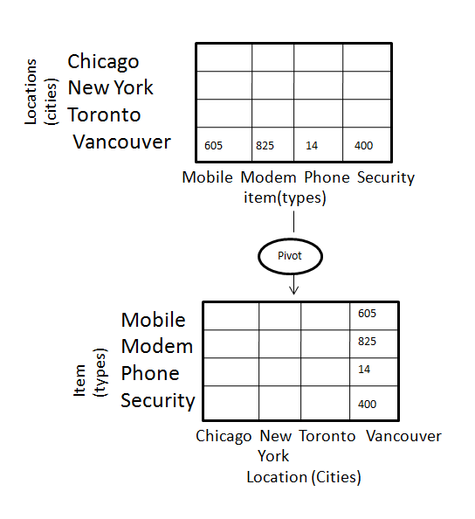
PIVOT
The pivot operation is also known as rotation.It rotates the data axes in view in order to provide an alternative presentation of data.Consider the following diagram showing the pivot operation
In this the item and location axes in 2-D slice are rotated

Slide 36
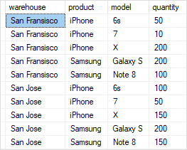

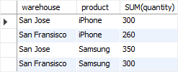
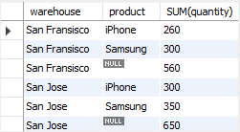
SELECT
warehouse, SUM(quantity)
FROM
inventory
GROUP BY warehouse;
SELECT
warehouse, product, SUM(quantity)
FROM
inventory
GROUP BY warehouse, product;
SELECT
warehouse, product, SUM(quantity)
FROM
inventory
GROUP BY ROLLUP (product);

Slide 37
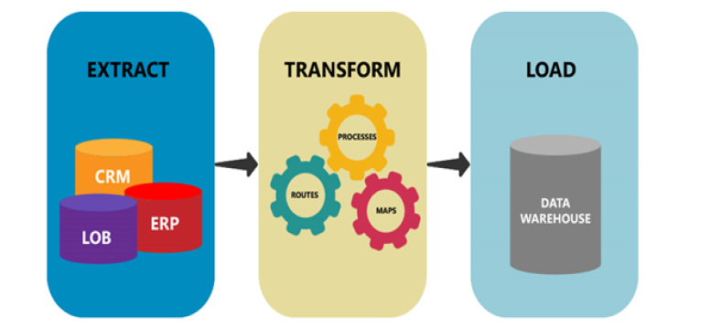

Slide 38
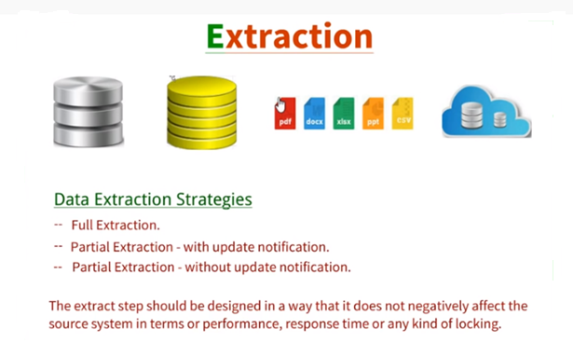

Slide 39
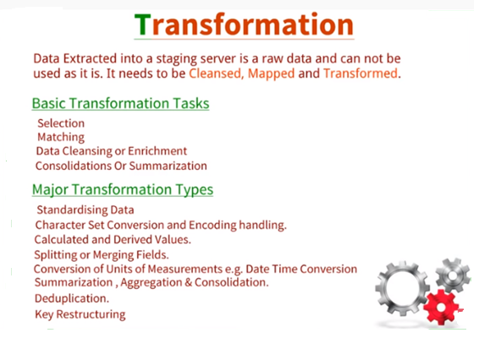

Slide 40
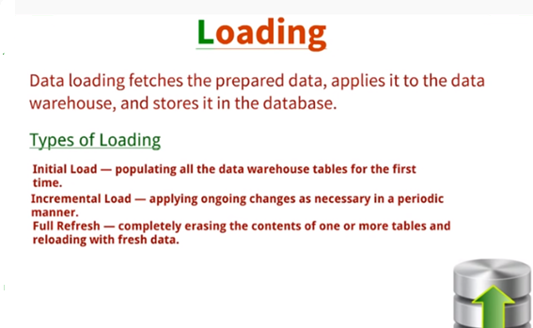

Slide 41
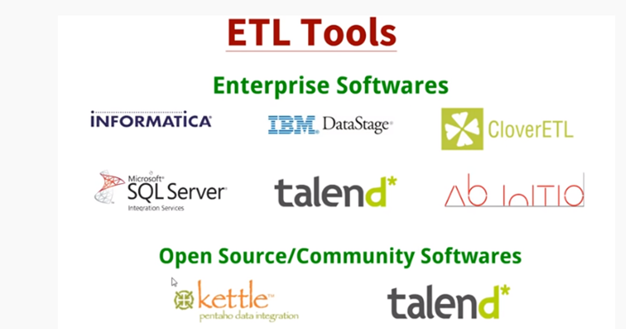

Slide 42
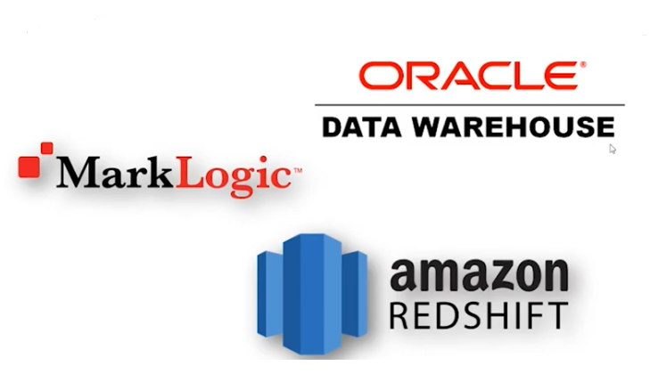
Datawarehouse Tools

Slide 43
OLAP Server Architectures
Relational OLAP (ROLAP)
Use relational or extended-relational DBMS to store and manage warehouse data and OLAP middle ware
Include optimization of DBMS backend, implementation of aggregation navigation logic, and additional tools and services
Greater scalability

Slide 44
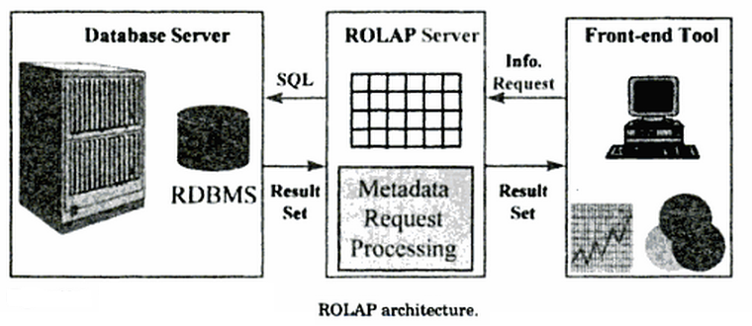
Relational OLAP (ROLAP)

Slide 45
OLAP Server Architectures
Multidimensional OLAP (MOLAP)
Sparse array-based multidimensional storage engine
Fast indexing to pre-computed summarized data

Slide 46
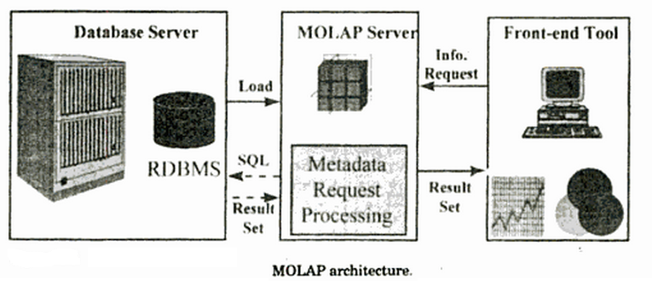
Multidimensional OLAP (MOLAP)

Slide 47
OLAP Server Architectures
Hybrid OLAP (HOLAP) (e.g., Microsoft SQLServer)
Flexibility, e.g., low level: relational, high-level: array
Specialized SQL servers (e.g., Redbricks)
Specialized support for SQL queries over star/snowflake schemas

Slide 48
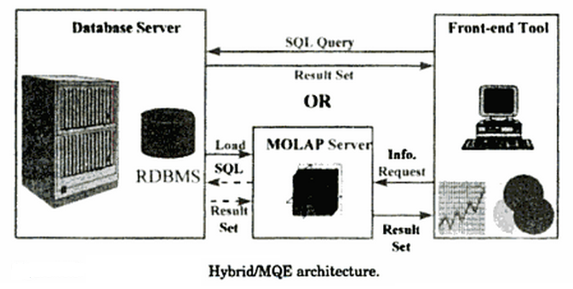
Hybrid OLAP (HOLAP)

